Slide 1
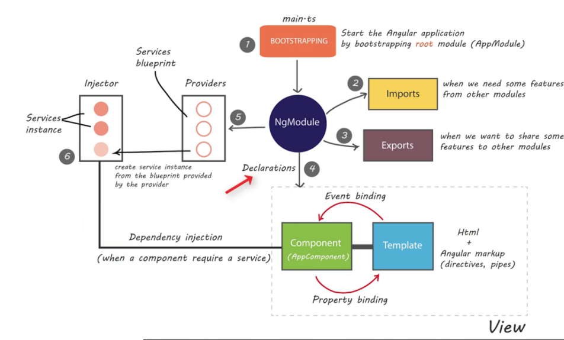
Angular Architecture

Slide 2
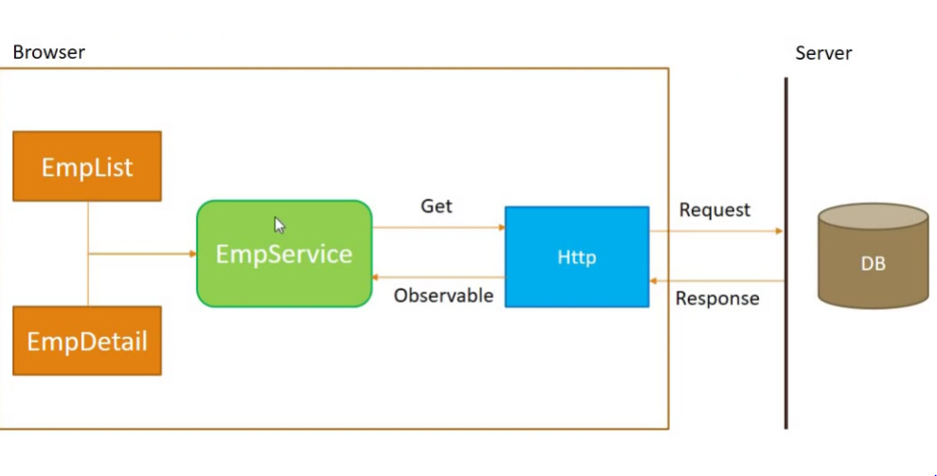
HTTP Mechanism

Slide 3
Ajax
Ajax- Asynchronous JavaScript and XML
AJAX just uses a combination of:
A browser built-in XMLHttpRequest object (to request data from a web server)
JavaScript and HTML DOM (to display or use the data)

Slide 4
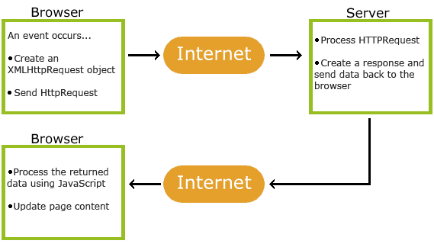
Ajax Working

Slide 5
Routing Module
Router uses to navigate between views or pages that trigger by the user actions. Its a standard behavior in the web application, PWA, or Mobile Apps.
The navigation or view changes happen when the user clicks on the link, click on the button, or enter the URL from the browser address bar.
Every view change can bring the params of data from the previous view to the next view.

